Slide 1
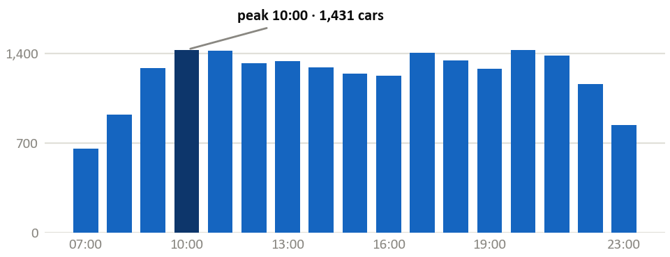
Parking Assessment
Parking: the demand side is now measured
Six representative areas surveyed 29 May – 3 June 2026 — occupancy, duration and turnover measured directly
93%
63%
55%
5–11
Peak occupancy, capacity-weighted
Stay one hour or less
Displaced demand vs. spaces removed
Vehicles per space per day
Vehicles parked, by hour of day — the kerb never empties between 09:00 and 22:00
April → June
• Then: displacement inferred from European BHLS precedent.
• Now: 908 cars displaced at the peak hour against 1,643 spaces removed — measured in Yerevan.
• Hourly licence-plate sweeps, 07:00–24:00, four working days.
2

Slide 2
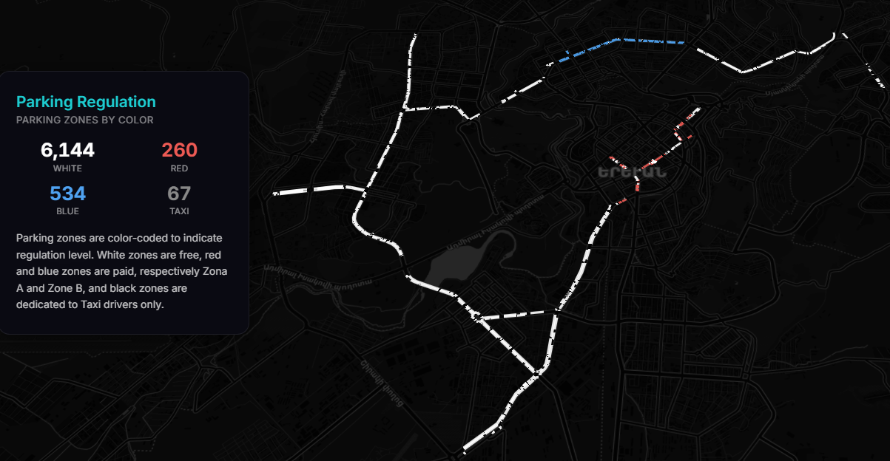
Parking Assessment
Supply baseline and corridor impact
15,897 spaces surveyed; the conceptual design removes 85% of on-corridor parking
15,897
7,005
Total spaces surveyed
On-street, on the corridors
5,953
1,052
Removed by the design
Retained or re-established
88% of it is free — and unorganised
Parking Regulation — yerevan-parking.vercel.app
• Only 20% has signage; 12% has markings.
Removal is inherent to the central-median cross-section — 1,836 / 3,310 / 807 across Corridors 1–3.
2

Slide 3
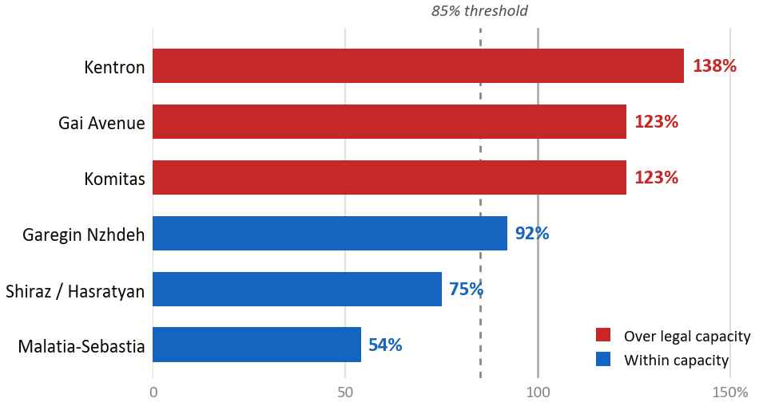
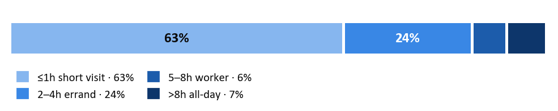
Parking Assessment
A saturated kerb — but a short-stay one
69% of zones sit above the 85% efficiency threshold at the peak, yet almost two-thirds of vehicles stay an hour or less
Peak occupancy by surveyed area
How long vehicles stay
What this rules out
• Visitor caps address a problem the data does not show — turnover is already 5–11 vehicles per space per day.
• All-day parking is only ~6%; overnight residential ~7%.
• Pricing, not maximum-stay enforcement, is the binding lever.
Occupancy above 100% is chronic overflow — more vehicles present than legal striped capacity. Only ~0.2% parked illegally: the issue is saturation, not illegality.
2

Slide 4
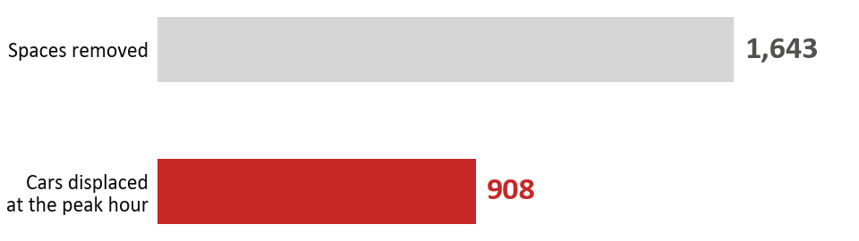
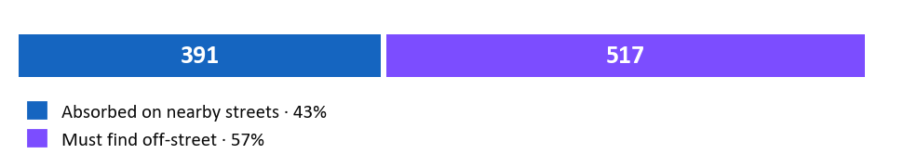
Parking Assessment
Displacement: measured, not inferred
Peak displaced demand is only 55% of the spaces removed — but re-absorption depends on opening gated yards
55%
92%
Displaced vs. removed
Of absorptive capacity is behind gates
Where those 908 cars can go
The condition attached
• Nearby streets absorb just 43% — 14% in Kentron, 0% in Komitas.
• The rest needs off-street capacity that is still gated, counted as if already open.
• So: open and manage the yards BEFORE removing kerb.
Surveyed areas only — a subset of the corridor-wide 5,953 removals.
2

Slide 5
Parking Assessment
Mitigation packages by sensitivity zone
Recalibrated by the survey: Komitas moves up to high sensitivity; Gai Avenue is handled as an exception
HIGH SENSITIVITY
MEDIUM SENSITIVITY
LOWER SENSITIVITY
Kentron CBD · 138% peak · 14% absorbed
Komitas · 123% peak · 0% absorbed
— moved up from medium by the survey
Arshakunyats · Kievyan
Substantial pressure, but more nearby capacity than the core
— orderly redistribution
Shiraz 75% · Malatia-Sebastia 54% peak
Bagratunyats, Sebastia, Raffi, Nor Nork
— structure before pricing
• Extend paid zones — lead
• Open residential yards — precondition
• Delivery spaces
• Resident permits
• Visitor caps — contingency only
• Extend paid zones
• Delivery spaces
• Park & ride where relevant
• Organise free parking
• Park & ride
• Open residential yards
Exception — Gai Avenue (Mega Mall)
• 123% peak. Even filling every nearby yard leaves demand unaccommodated (89% best case) — so the kerb parking stays for now, to be revisited as the area changes.
2

